Slide 1
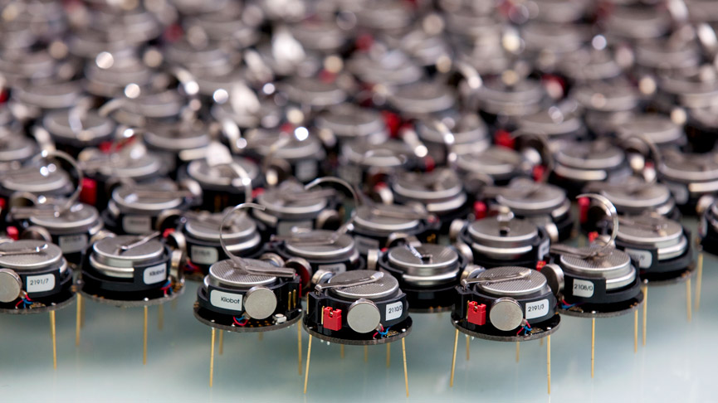

BY :-
ROHAN BADADE:- (3163005)
VAIBHAV BAKLIWAL:- (3163006)
KIRAN CHOPADE:- (3163019)

Slide 2

WHAT IS A SW ARM?
• swarm is the collective motion of a large number of selfpropelled entities.

Slide 3

SWARM ROBOTICS
Swarm Robotics is an approach to the coordination of
multi robot systems which consist of group of micro robots.

Slide 4
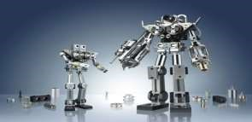
ADVANTAGES
Man power not required.
Low cost.
Easy to use.
Can be used to do the tasks which are hazardous for humans
Time consumption is less.

Slide 5
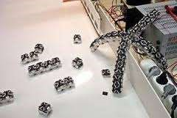
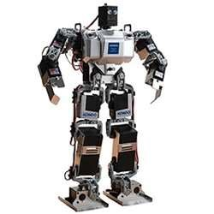
SINGLE ROBOT VS SWARM ROBOT

Slide 6
Sometimes it is impossible to complete a task by a single person or it becomes quite difficult to that person to complete the work.
In such cases, there is need of a team or group of members that can collaboratively work and make the work of the person or the user very much easy.

Slide 7
Categories in swarm
MASTER SLAVE
This controls all the other robots This will be controlled by the
in swarm. master robots
There will be only one master. There are so many slaves present in a swarm application.
They are intended to guide They are intended to do
the slaves. Certain task given by the
master

Slide 8
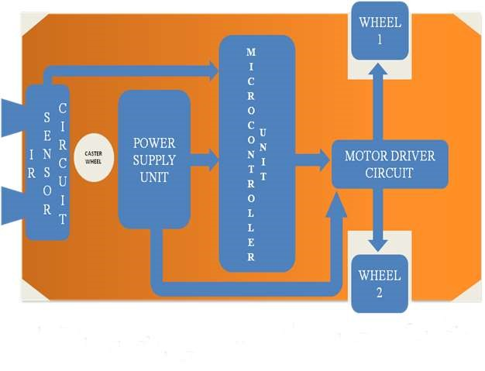
BASIC PARTS OF A ROBOT: Microcontroller Motors Sensors

Slide 9
Swarm Robotics Block Diagram
nrf module
IR
SENSORS
LPC 2148
MOTOR 1
L293D
ult sensor
MOTOR 2
(
DRIVER
IC)

Slide 10
Block diagram description
A microcontroller which is interfaced with an array of IR sensors, these IR sensors are fixed on the robot in such a way that they can sense any object present near its surroundings.
The output of IR sensors is fed to the microcontroller that is programmed to take self decisions over changing the direction of the robot movement.
The position control of the robot is achieved by DC motors and their drivers.

Slide 11
HARDWARE COMPONENTS
LPC2148 Micro Controller
IR Sensors
L293D IC
Motors

Slide 12
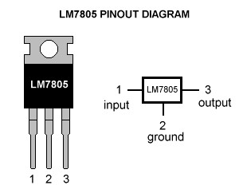
Capacitor
A capacitor is a two terminal passive electronic component consisting of a pair of conductors separated by a dielectric.
The capacitor blocks DC current and allows AC current .
Regulator
Voltage regulator ICs are available with fixed
(typically 5, 12 and 15V) or variable output voltages.

Slide 13
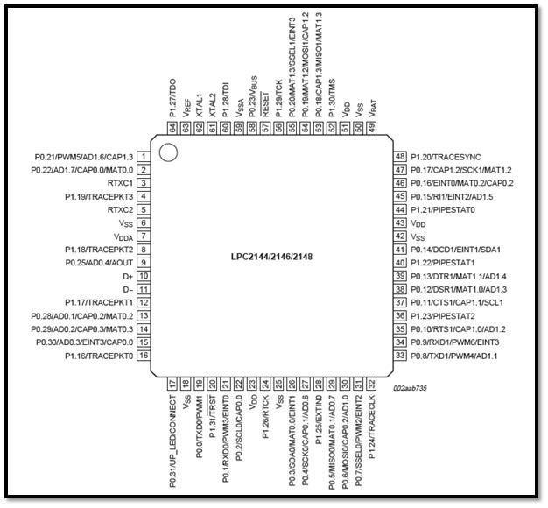
LPC2148 Micro Controller Pin Diagram

Slide 14
Features of LPC2148
It has 2 ports ,each port consist of 32 pins total 64 pins.
LPC2148 is the widely used IC from ARM-7 family.
The ARM7 is a general purpose 32-bit microcontroller, which offers high performance and very low power consumption.
It is manufactured by Philips.
LPC2148 is a LQFP64 package.It is a RISC processor.
Ram 32kb,Rom 512kb.

Slide 15
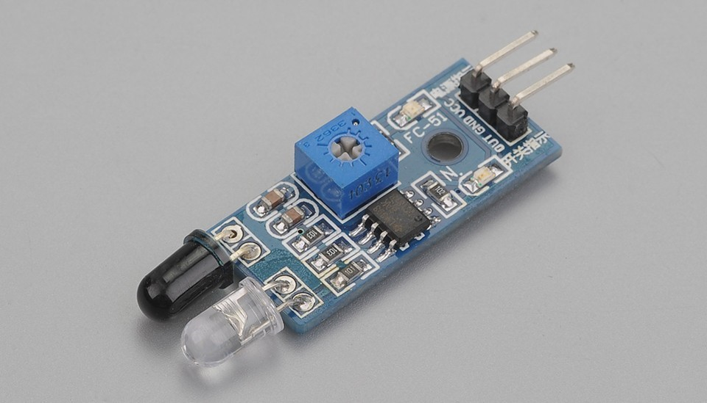
IR Sensors
Need Of IR Sensor
Because it has a good range which fulfills our requirements.
It is very low cost and can be constructed on general purpose PCB.
It is of very small size.

Slide 16
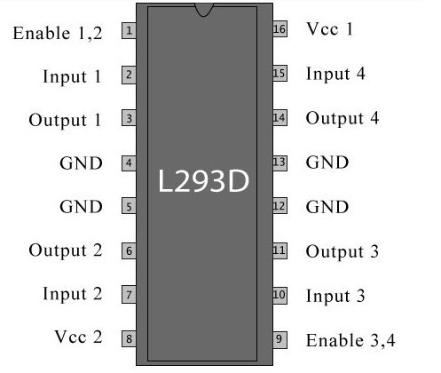
L293D IC
It is a 16 pin configuration.
L293D is a motor driver integrated circuit (IC).
Motor drivers act as current amplifiers since they take a low-current control signal and provide a higher-current signal.
This higher current signal is used to drive the motors.

Slide 17
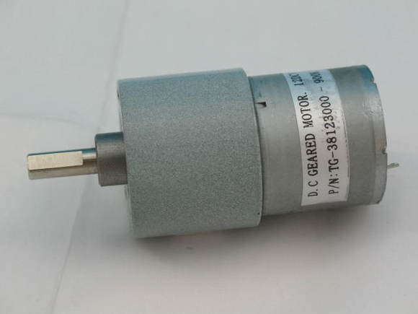
Motors
An Electric DC motor is a machine which converts electric energy into mechanical energy.
The working of DC motor is based on the principle that when a current-carrying conductor is placed in a magnetic field, it experiences a mechanical force.

Slide 18
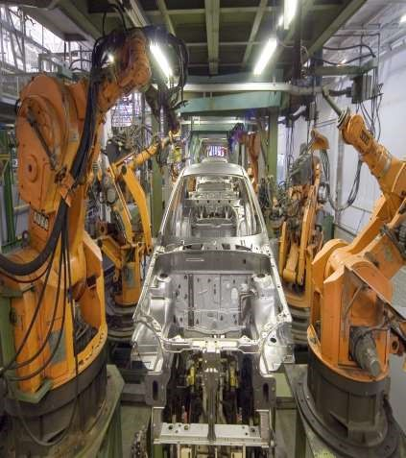
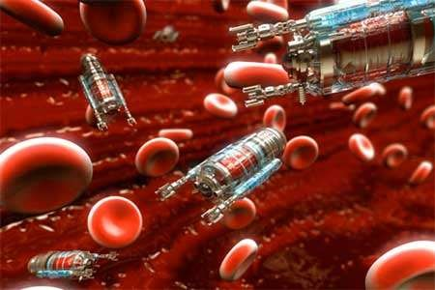

Applications:
In Industries,medicine

Slide 19
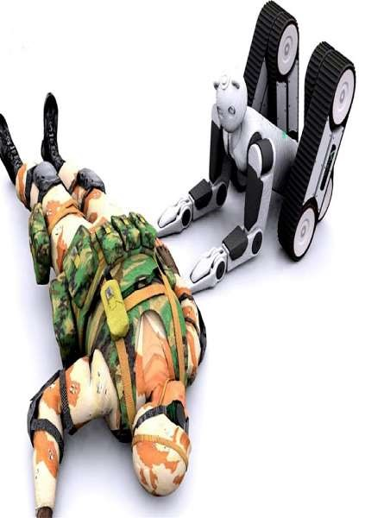
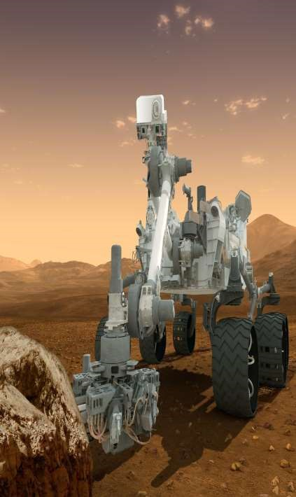
In Military , space research

Slide 20
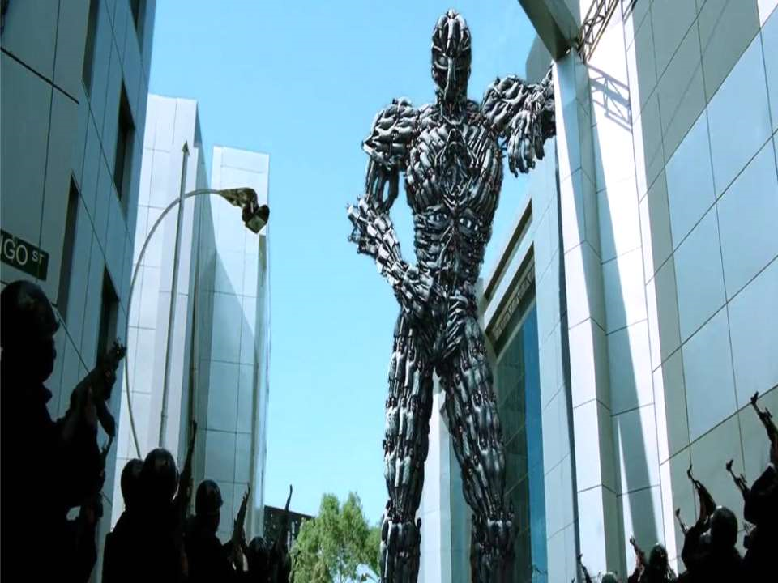
THANK YOU

